Slide 1

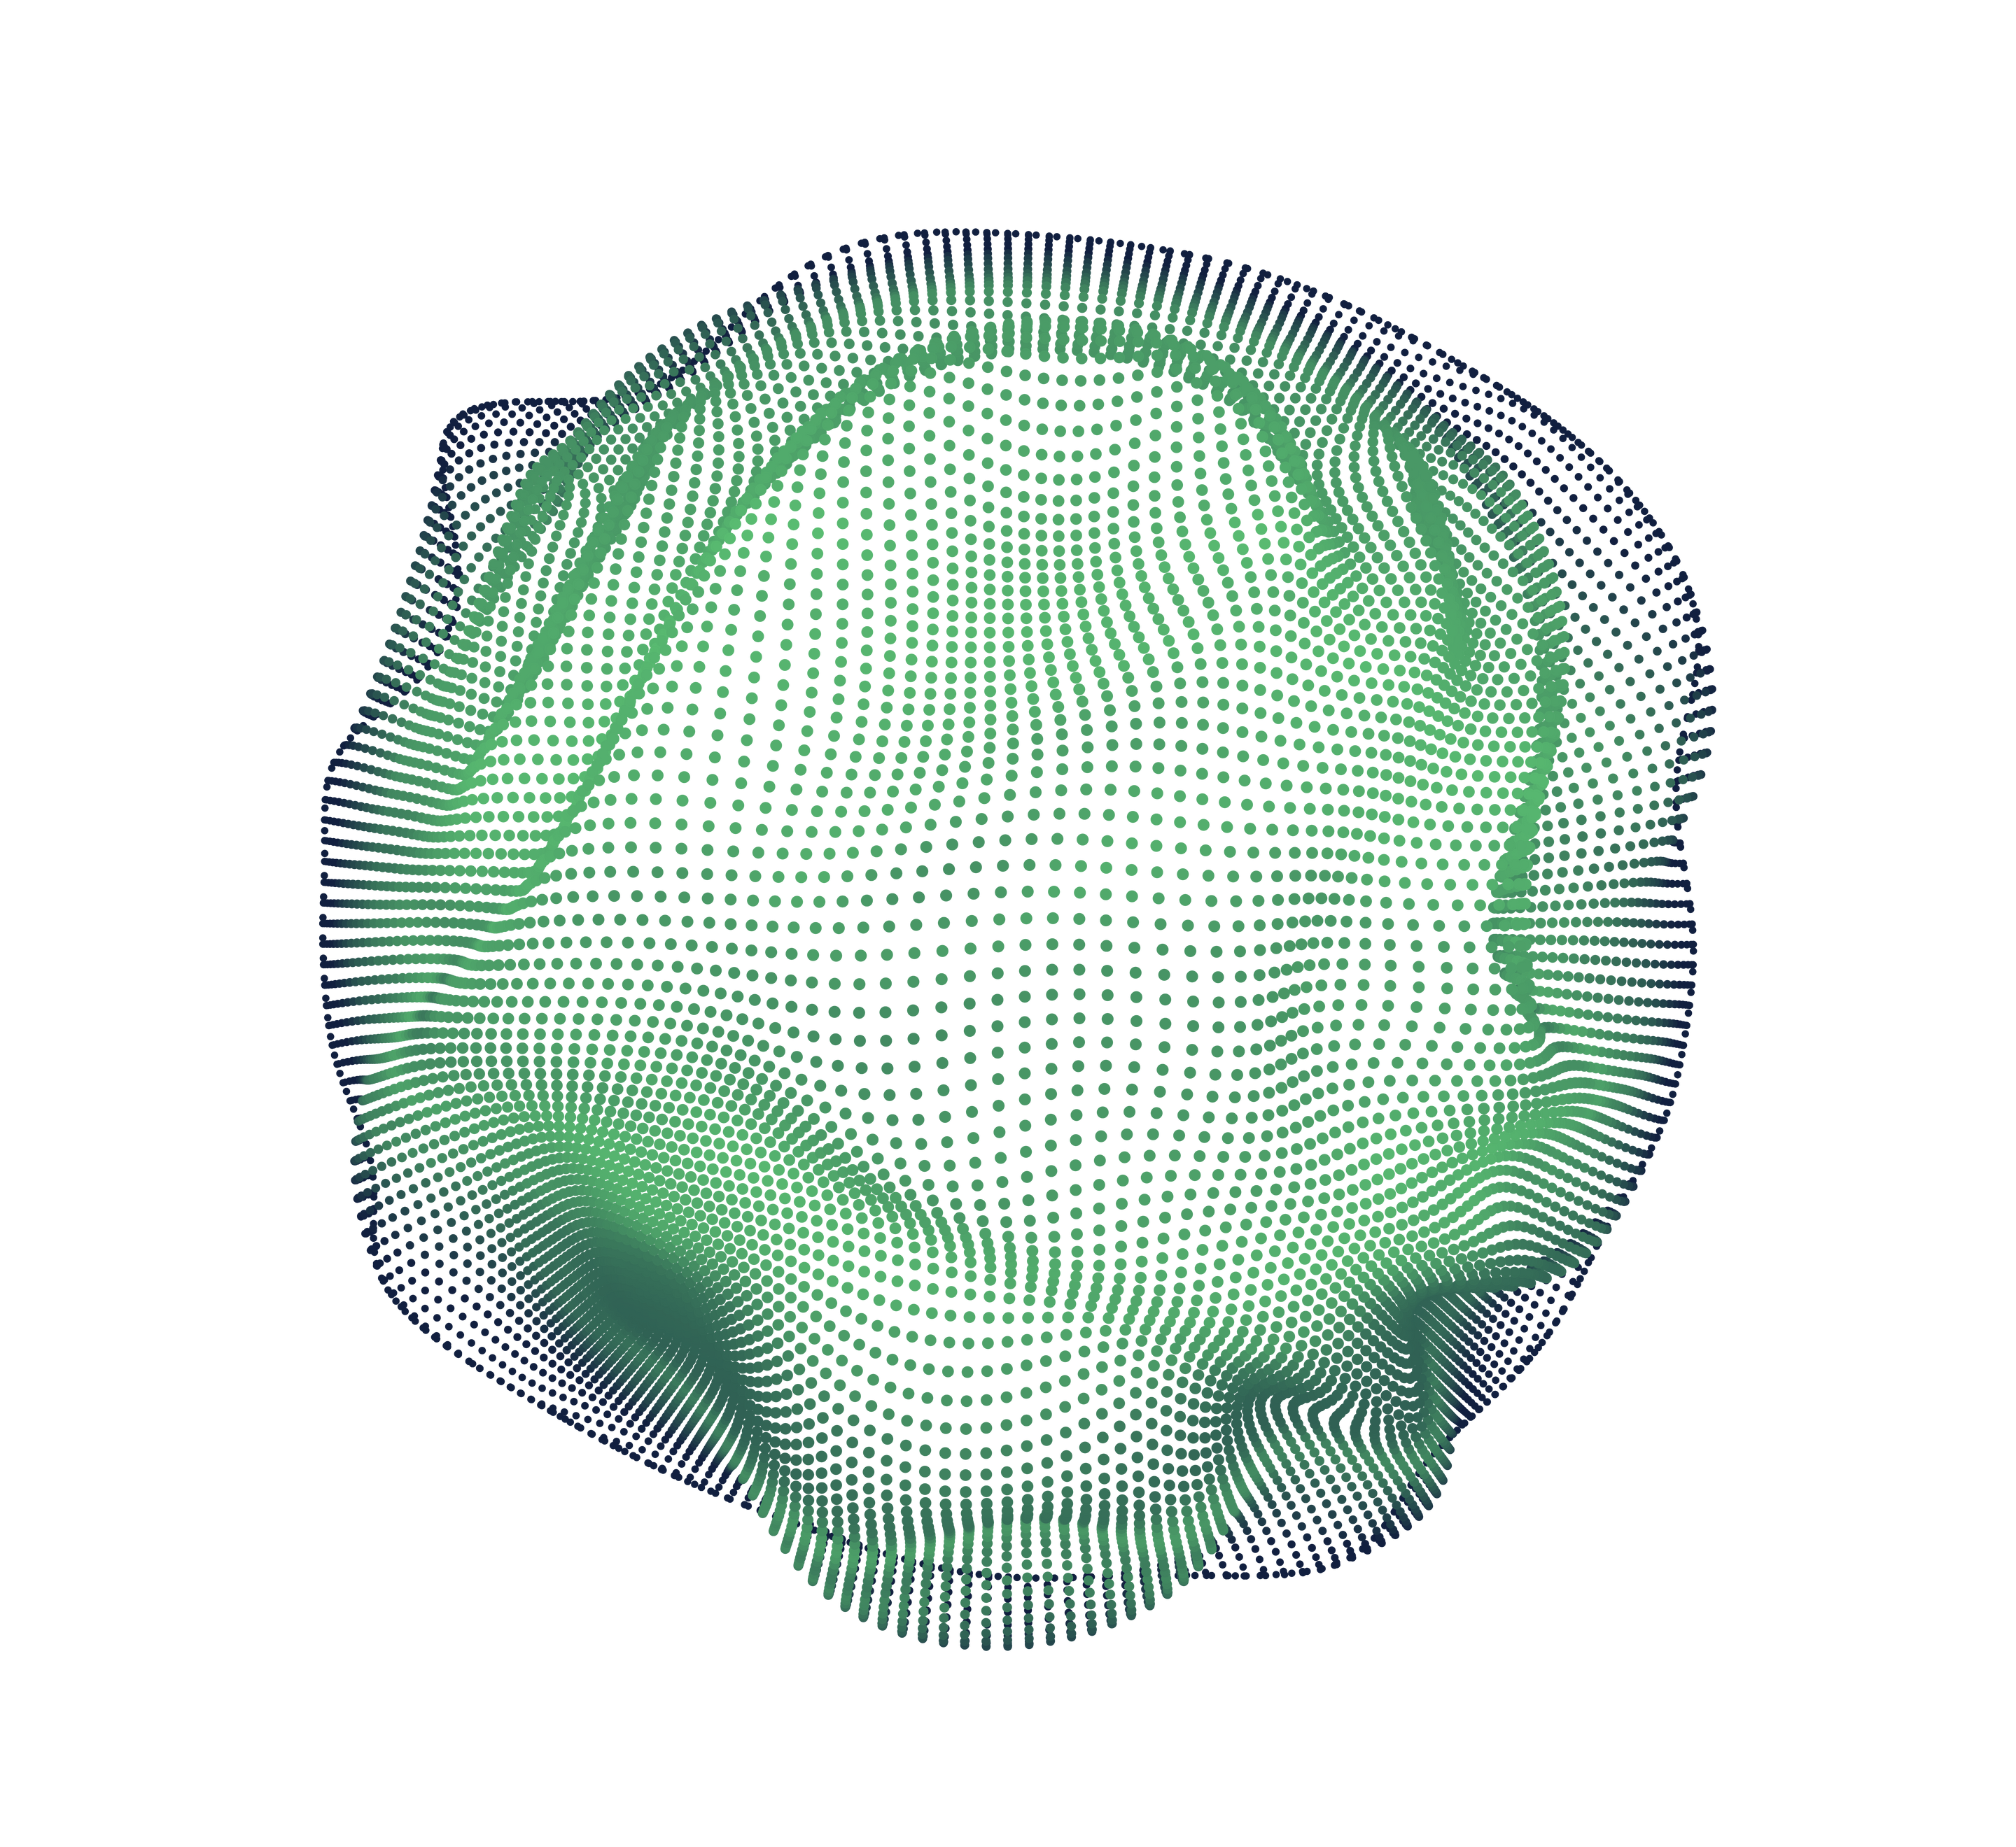

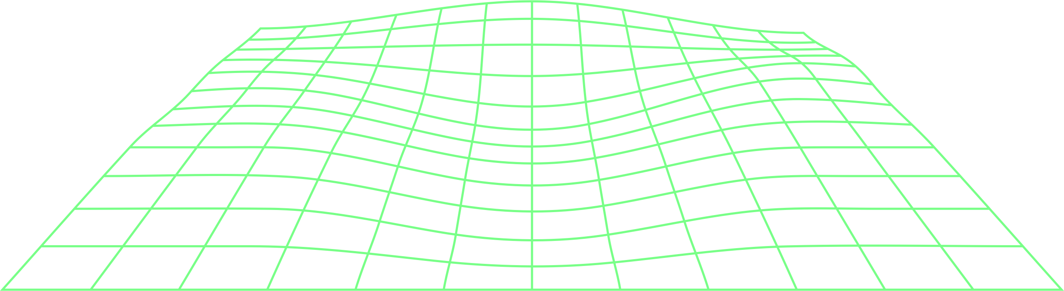
Multi-Agent Systems for
Performance and Strategy Optimizations in Formula 1 Racing
Nicolae Mogage – ICA

Slide 2
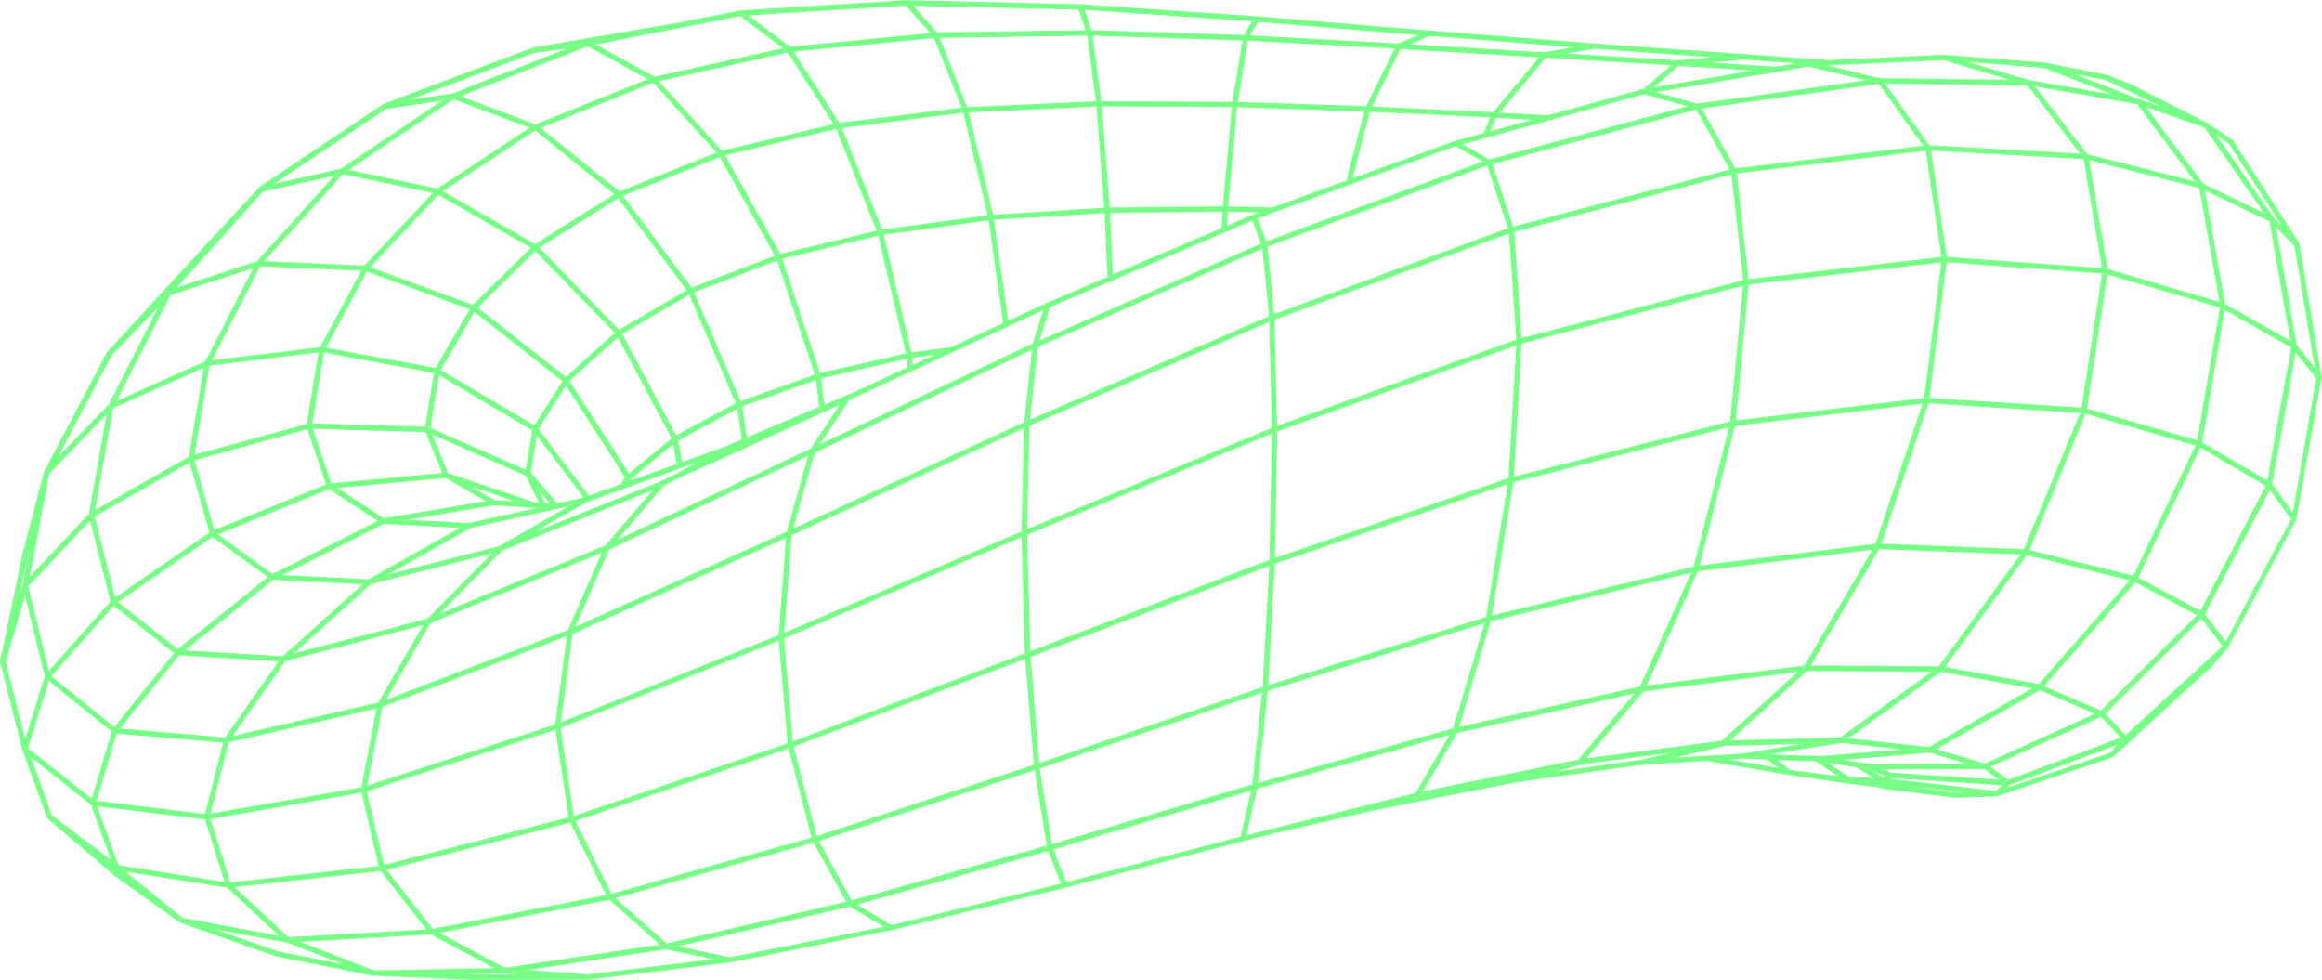
CONTENT
O
O
1
EXPERIMENTS
2
RESULTS
O
3
CONCLUSIONS

Slide 3

↖ ↗
↘ ↙
1
Experiments

Slide 4
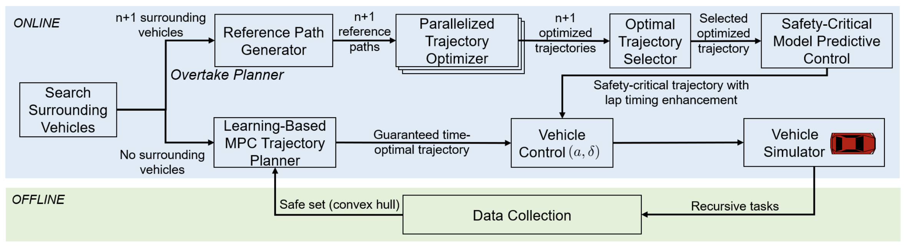

Autonomous Racing with
Multiple Vehicles

Slide 5
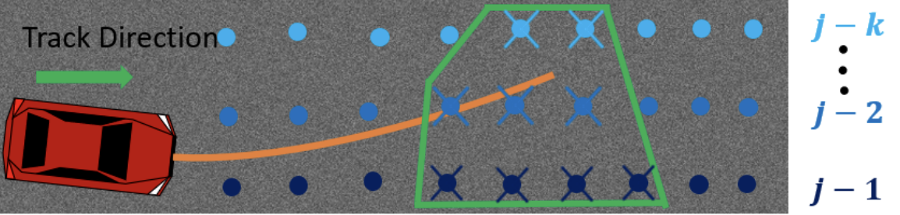
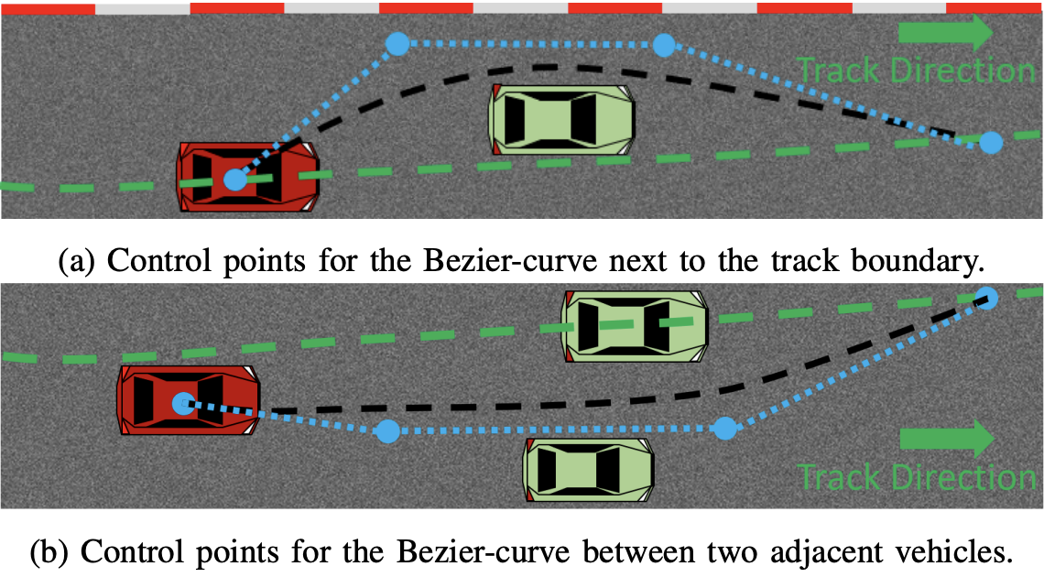
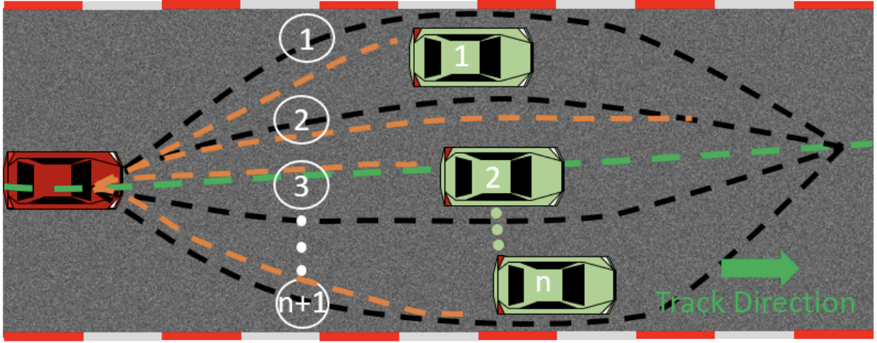
Autonomous Racing with Multiple Vehicles

Slide 6
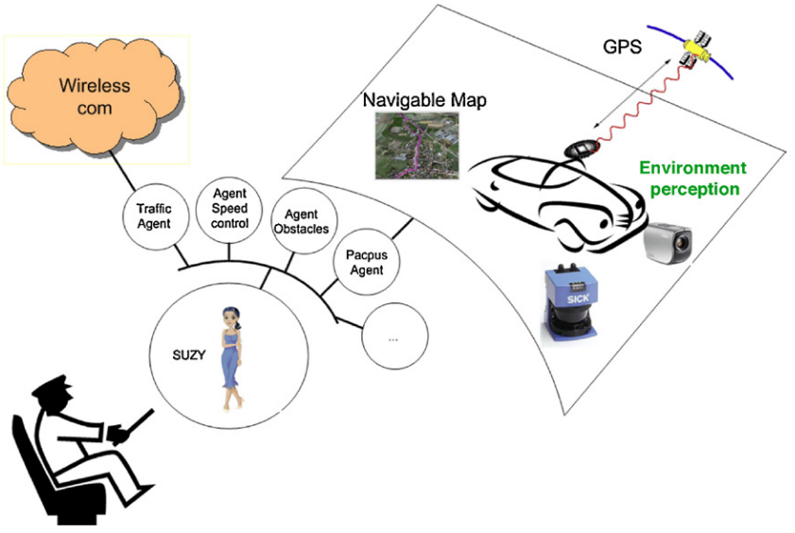
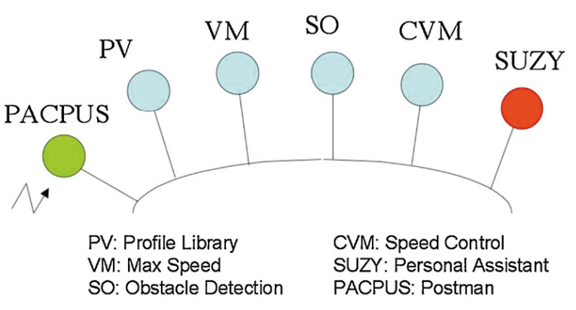
Multi-Agent Active Collaboration Between
Drivers and Assistance Systems

Slide 7
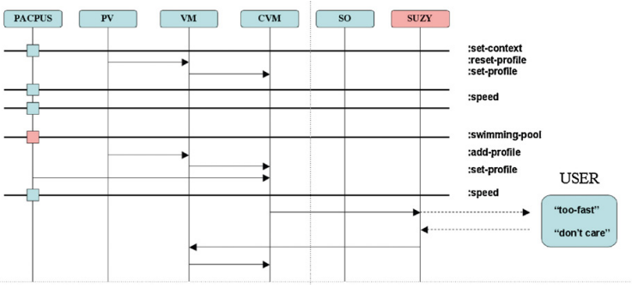
Multi-Agent Active Collaboration Between
Drivers and Assistance Systems

Slide 8
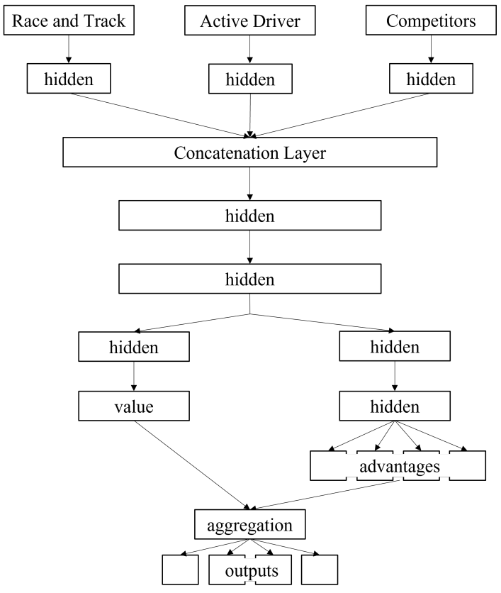
S-MARL: An Algorithm for Single-To-Multi-Agent Reinforcement Learning

Slide 9
Game-theoretic Energy Management Strategies
With Interacting Agents in Formula 1
Stackelberg Game
Drag Reduction Model
Energy Management Strategies

Slide 10
Game Theory in Formula 1: Multi-agent Physical and Strategical Interactions
Game formulations
Multi-agent, Drag and Downforce Interactions

Slide 11
↖ ↗
↘ ↙
2
Results

Slide 12
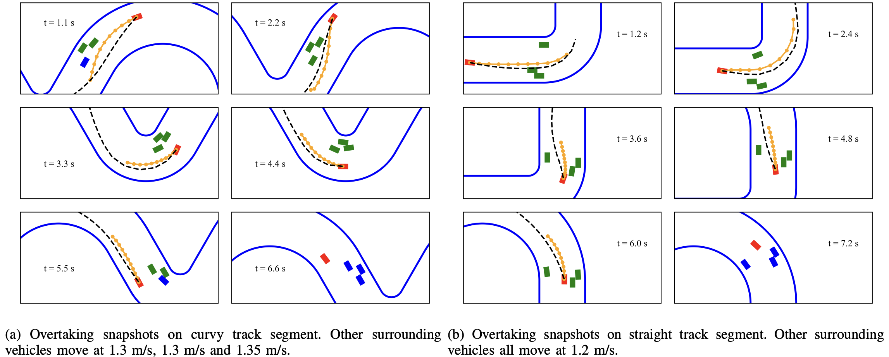
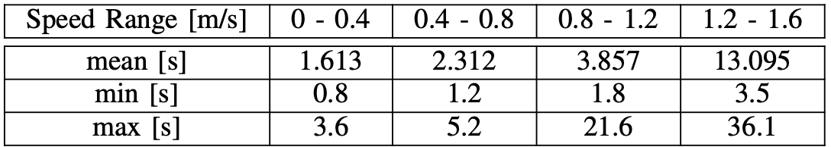
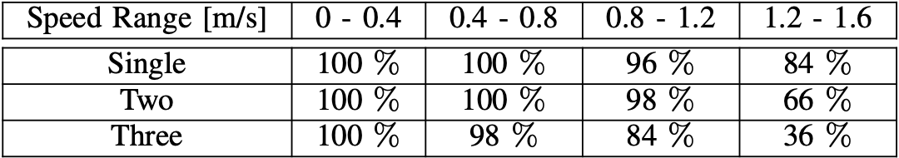
Autonomous Racing with
Multiple Vehicles

Slide 13
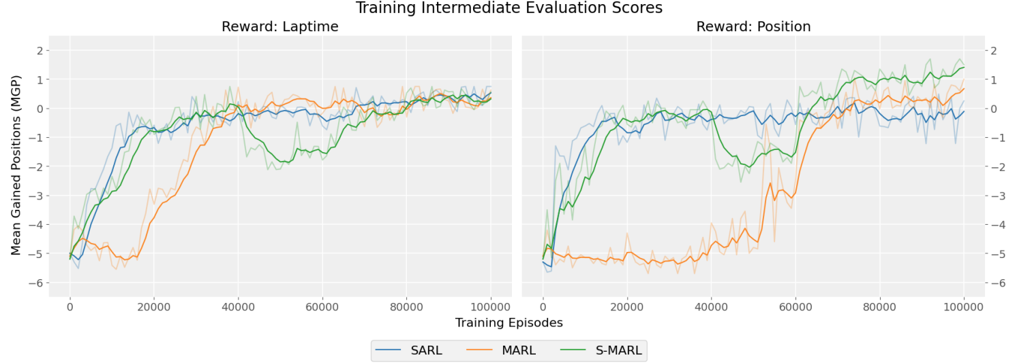
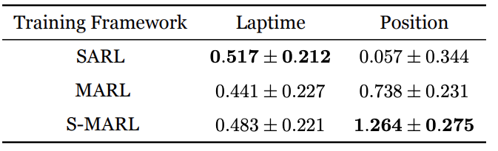
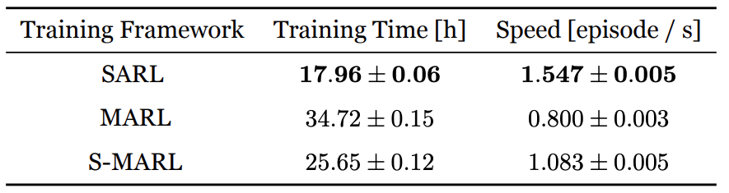
S-MARL: An Algorithm for Single-To-Multi-Agent Reinforcement Learning

Slide 14
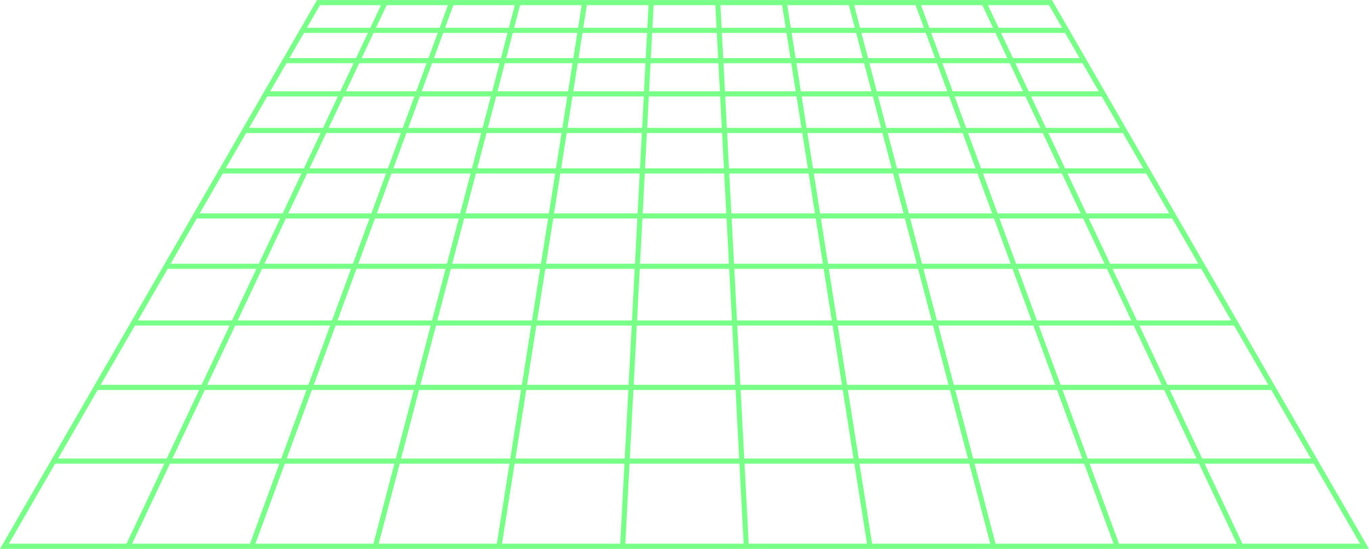
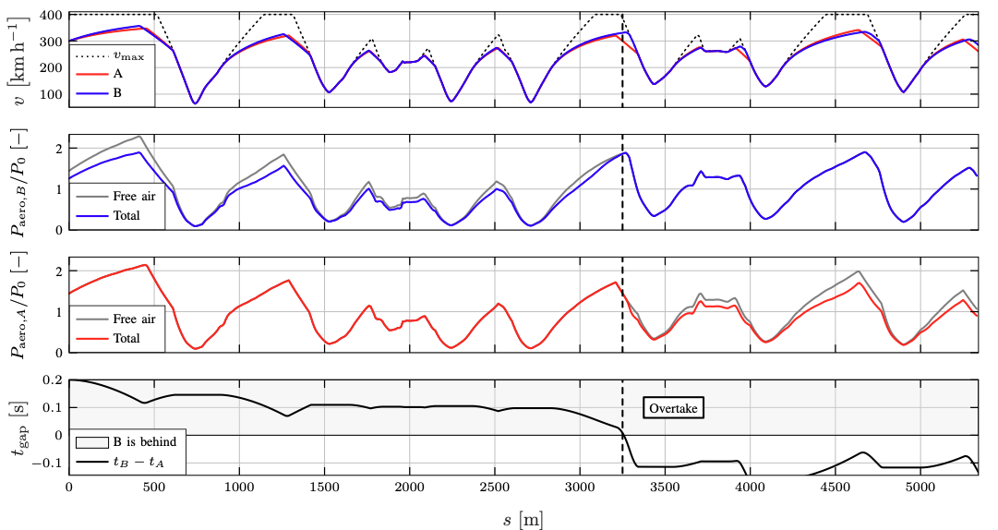
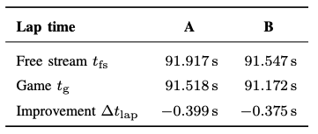
Game-theoretic Energy Management Strategies
With Interacting Agents in Formula 1

Slide 15
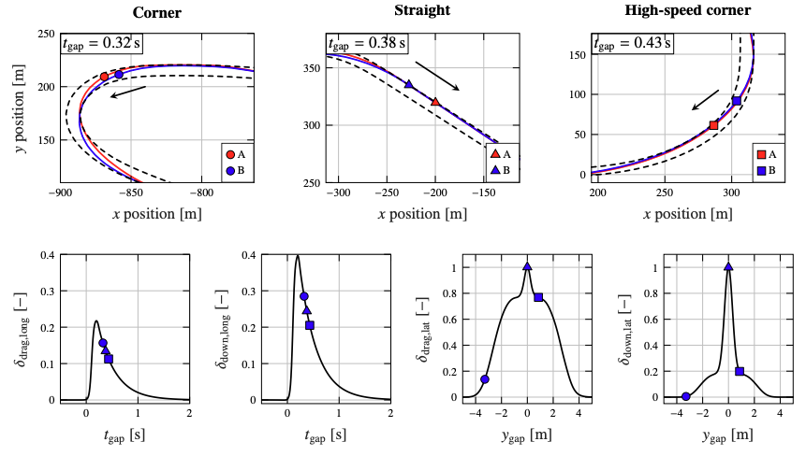
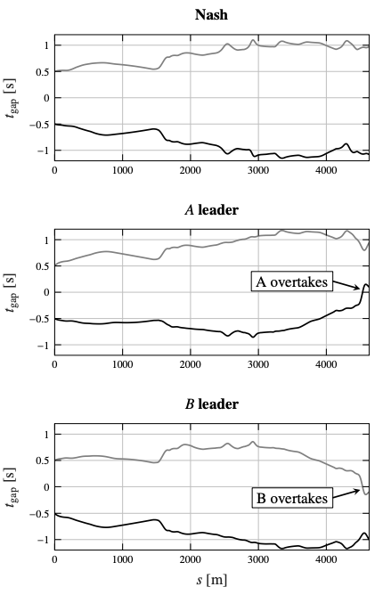
Game Theory in Formula 1: Multi-agent
Physical and Strategical Interactions

Slide 16
↖ ↗
↘ ↙
4
Conclusions

Slide 17
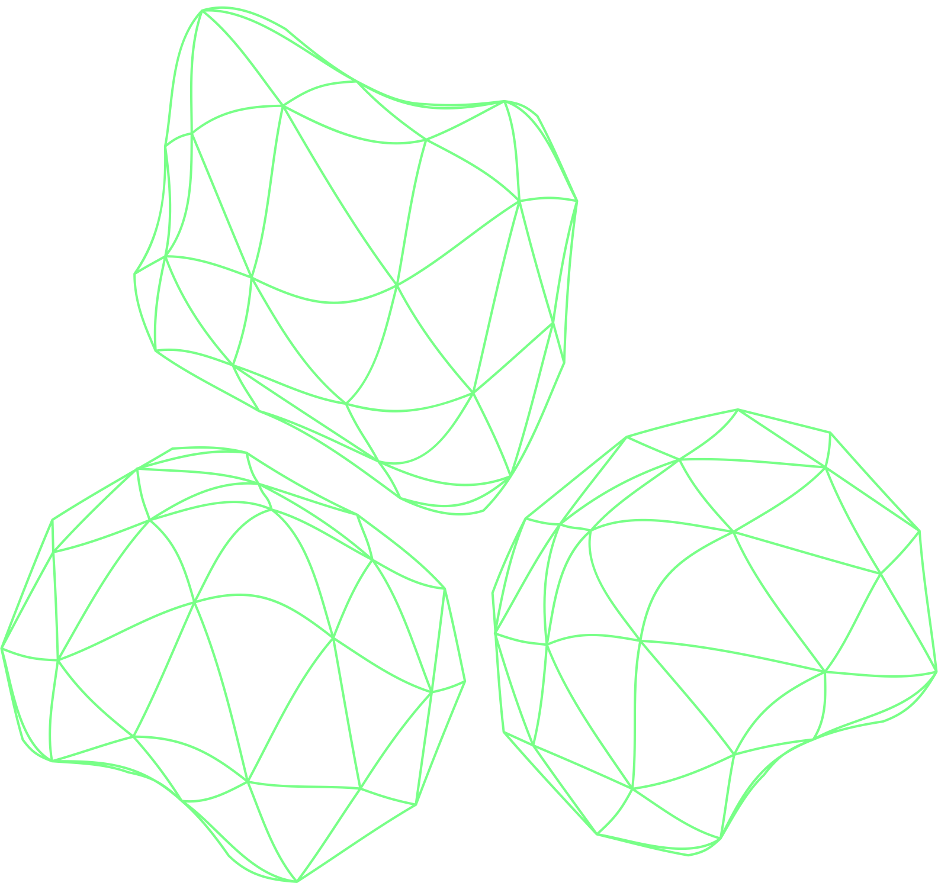
THANK YOU!

